Slide 1


PAYTM DATA
Project by Vidyadhari.

Slide 2


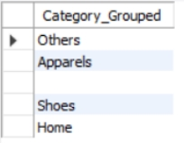
What does the "Category_Grouped" column represent, and how many unique categories are there?
SELECT COUNT(DISTINCT Category_Grouped) AS unique_categories_count
FROM paytmdata;
SELECT DISTINCT Category_Grouped
FROM Paytmdata;

Slide 3
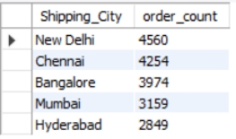
2. List the top 5 shipping cities in terms of the number of orders.
SELECT Shipping_City, COUNT(*) AS order_count
FROM paytmdata
GROUP BY Shipping_City
ORDER BY order_count DESC
LIMIT 5;

Slide 4
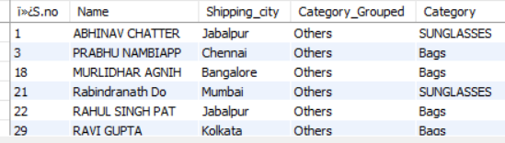
3. Show me a table with all the data for products that belong to the "others" category.
SELECT *
FROM paytmdata
WHERE Category_Grouped = 'others’;

Slide 5
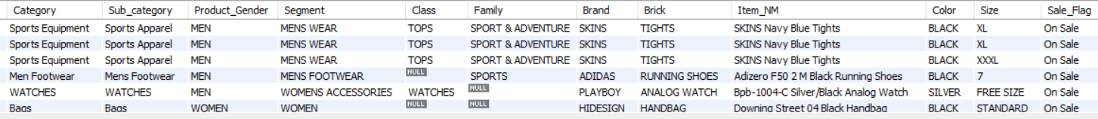
4.Filter the data to show only rows with a "Sale_Flag" of ‘on sale’
SELECT *
FROM paytmdata
WHERE Sale_Flag = 'on sale';

Slide 6
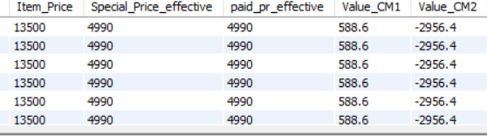
5. Sort the data by "Item_Price" in descending order.
Select *from paytmdata order by item_price desc;

Slide 7
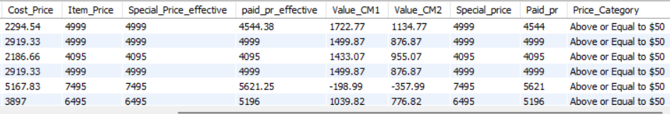
6. Apply conditional formatting to highlight all products with a "Special_Price_effective" value below $50 in red.
SELECT*,
CASE
WHEN Special_Price_effective < 50 THEN 'Below $50'
ELSE 'Above or Equal to $50'
END AS Price_Category
FROM
paytmdata;

Slide 8
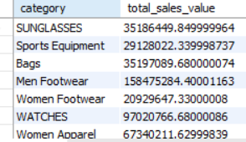
7. Create a pivot table to find the total sales value for each category.
select category ,sum(cost_price + item_price) as total_sales_value from paytmdata group by category;

Slide 9
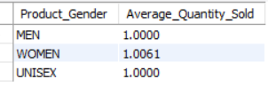
8 .Calculate the average "Quantity" sold for products in the "Clothing" category, grouped by "Product_Gender."
SELECT Product_Gender,
AVG(Quantity) AS Average_Quantity_Sold
FROM paytmdata
WHERE Category = 'watches'
GROUP BY Product_Gender;

Slide 10
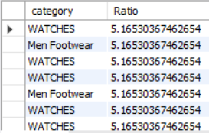
9. Find the top 5 products with the highest "Value_CM1" and "Value_CM2" ratios.
SELECT category,
(Value_CM1 / Value_CM2) AS Ratio
FROM Paytmdata
ORDER BY Ratio DESC ;

Slide 11
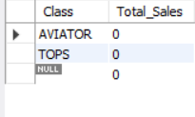
10.Find the total sales for each "Brand" and display the top 3 brands in terms of sales.
SELECT Class, SUM(brand) AS Total_Sales
FROM paytmdata
GROUP BY Class
ORDER BY Total_Sales DESC limit3;

Slide 12

11. Calculate the total revenue generated from "bags" category products with a "Sale_Flag" of 'not on sale’.
select sum(cost_price+ item_price) as total_revenue from paytmdata where category ='bags' and sale_flag='not on sale';

Slide 13
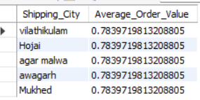
12. Identify the top 5 shipping cities based on the average order value (total sales amount divided by the number of orders) and display their average order values
SELECT Shipping_City,
AVG(cost_price/item_price) AS Average_Order_Value
FROM paytmdata
GROUP BY Shipping_City
ORDER BY Average_Order_Value DESC
LIMIT 5;

Slide 14

13. Determine the total number of orders and the total sales amount for each "Product_Gender" within the "women footwear" category.
SELECT Product_Gender,
COUNT(*) AS Total_Number_of_Orders,
SUM(cost_price+ item_price) AS Total_Sales_Amount
FROM paytmdata
WHERE Category = 'women footwear'
GROUP BY Product_Gender;

Slide 15
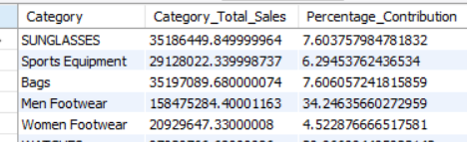
14 Calculate the percentage contribution of each "Category" to the overall total sales.
SELECT Category,
SUM(cost_price+item_price) AS Category_Total_Sales,
(SUM(cost_price+item_price) / (SELECT SUM(cost_price+item_price) FROM paytmdata)) * 100 AS Percentage_Contribution
FROM paytmdata
GROUP BY Category;

Slide 16
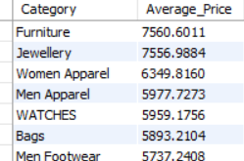
15. Identify the "Category" with the highest average "Item_Price" and its corresponding average price
SELECT Category,
AVG(Item_Price) AS Average_Price
FROM paytmdata
GROUP BY Category
ORDER BY Average_Price DESC;

Slide 17
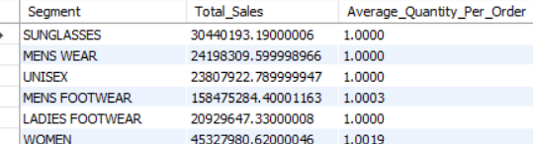
16. Calculate the total sales for each "Segment" and the average quantity sold per order for each segment.
SELECT Segment,
SUM(cost_price+item_price) AS Total_Sales,
AVG(Quantity) AS Average_Quantity_Per_Order
FROM paytmdata
GROUP BY Segment;

